Slide 1
Design, Develop, Implement & Document Community Portal Website
Module Project
Module: Web Development Foundations
Course: NICF Advanced Certificate in Software & Applications (Development & Deployment)
Start Date : 13 September 2022
End Date :
Submission Date : 19 September 2022
Learner Name : Ida Bagus Ketut Yoghantara
Enrollment ID : BDSE04-0322
Presentation Date :

Slide 2
Contents
Document History
Version Number | Effective Date of release | Summary of Included Changes | Author
1 | 4th March 2016 | First Edition | Satya CVS
2 | 08th Sep 2017 | Changed for Module 5 | Shrinivas K R
3 | 20th Jul 2018 | Changed for Module 5 RQF | Shrinivas K R

Slide 3
Contents
Contents
S. No. | Description
01 | Development Tools
02 | Business Process
03 | Application Block Diagram
04 | Applications
05 | Models, Controllers & Classes Developed
06 | UI Design
07 | Includes
08 | Software Development Methodology
09 | Project Plan
10 | Application Screen Shots
11 | Project Milestones & Tasks
12 | Milestone Feedback & Action Taken
13 | Modifications Made On Feedback
14 | Project Results
15 | Proposed Improvements

Slide 4
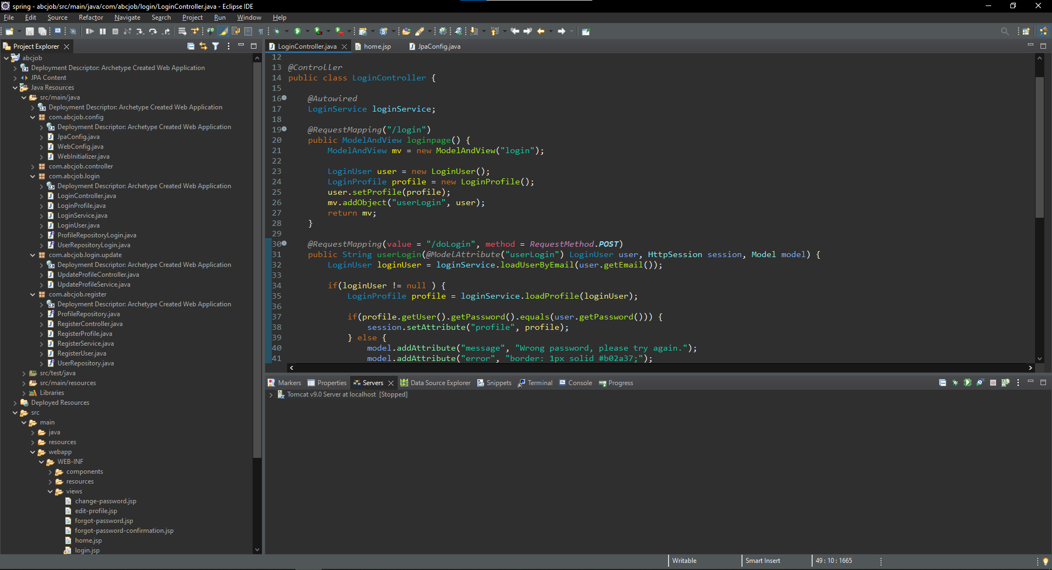
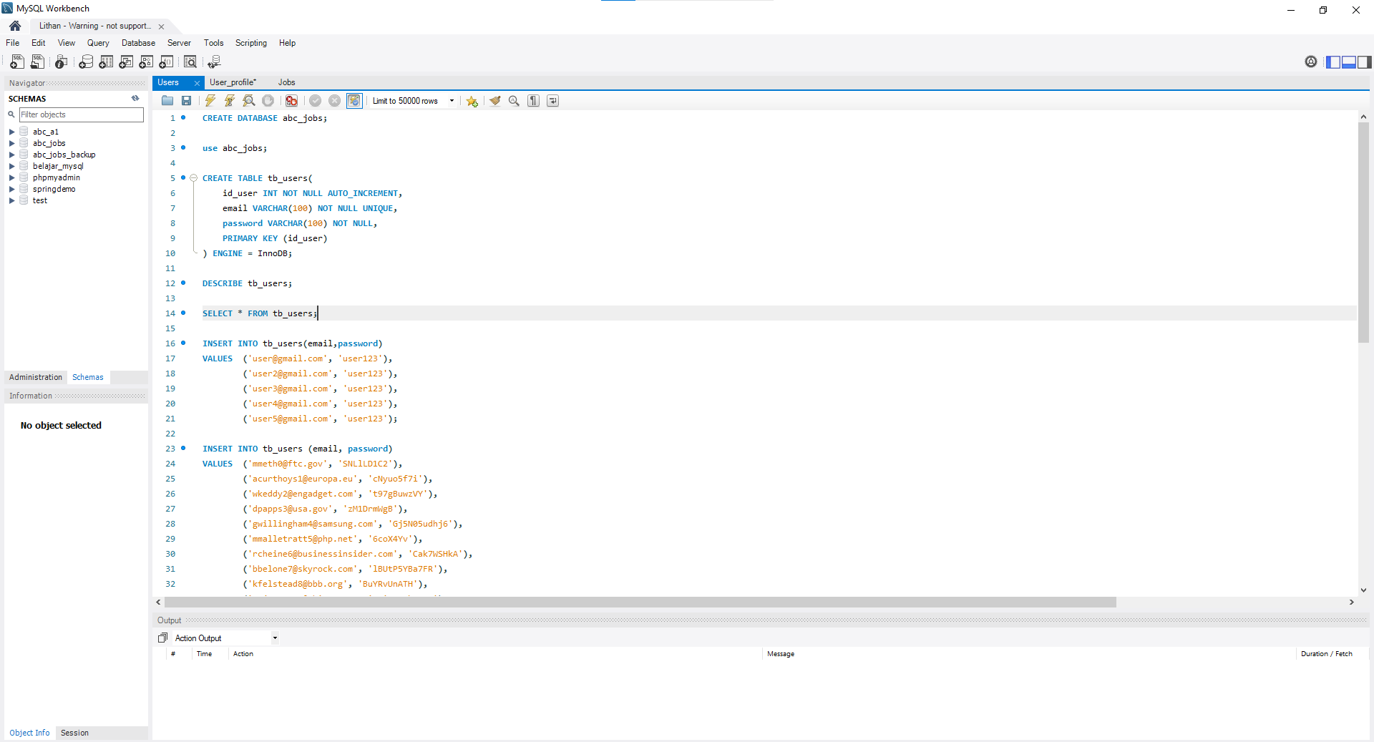
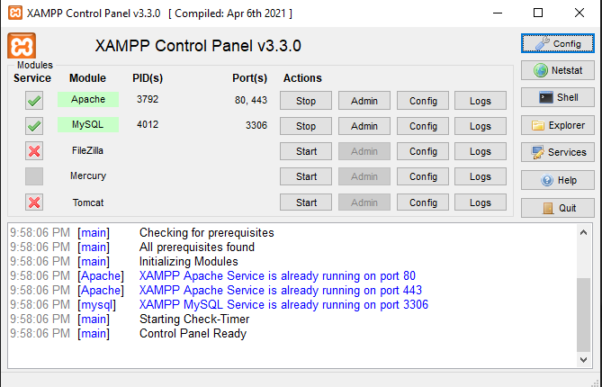
1. Development Tools
Development Tools Screen captures
Eclipse IDE
MySQL Workbench
XAMPP

Slide 5
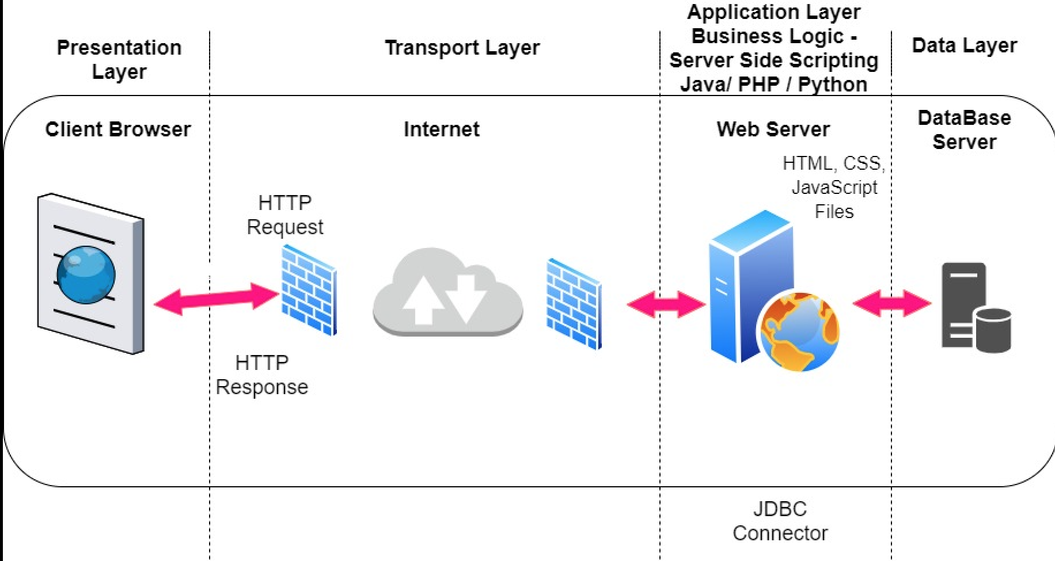
2. Business Process
Block Diagram of Various Business Process

Slide 6
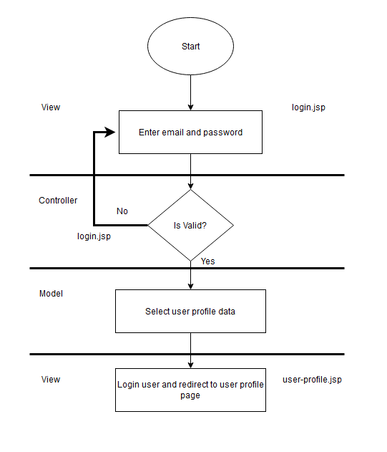
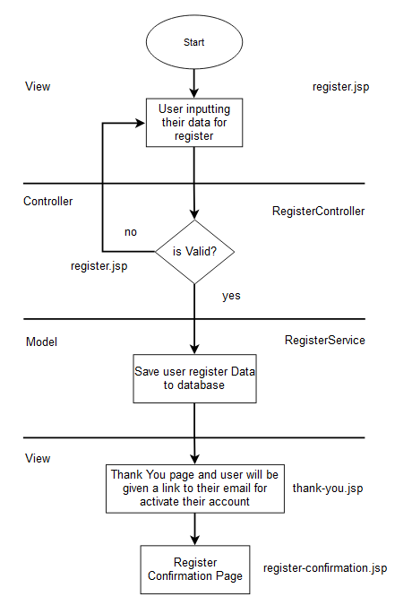
2. Business Process
Login
Register

Slide 7
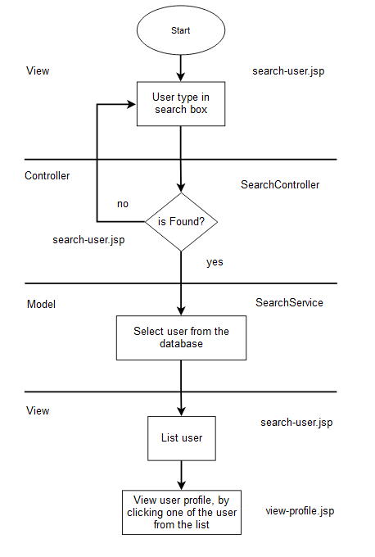
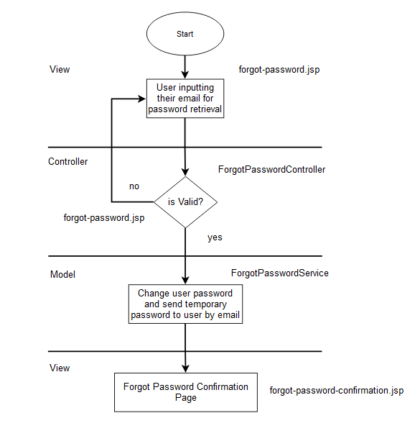
2. Business Process
Search User
Forgot Password

Slide 8
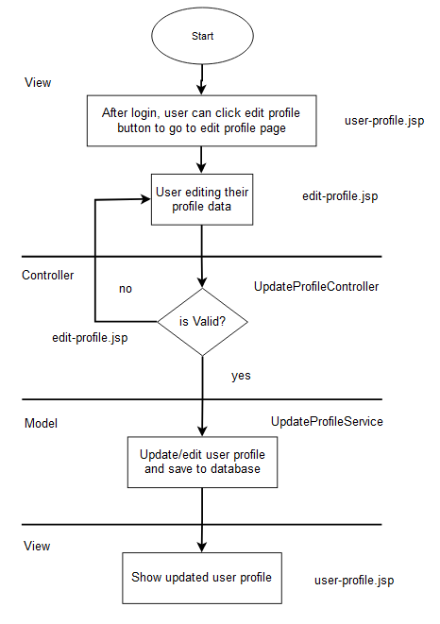
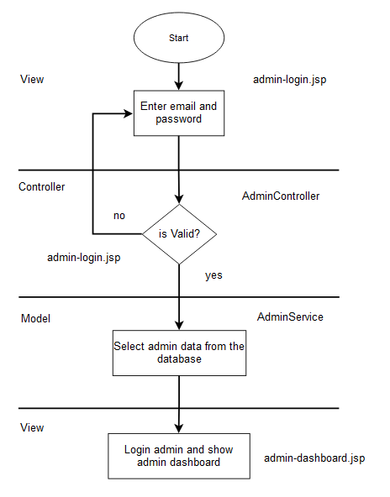
2. Business Process
Update Profile
Admin Login

Slide 9
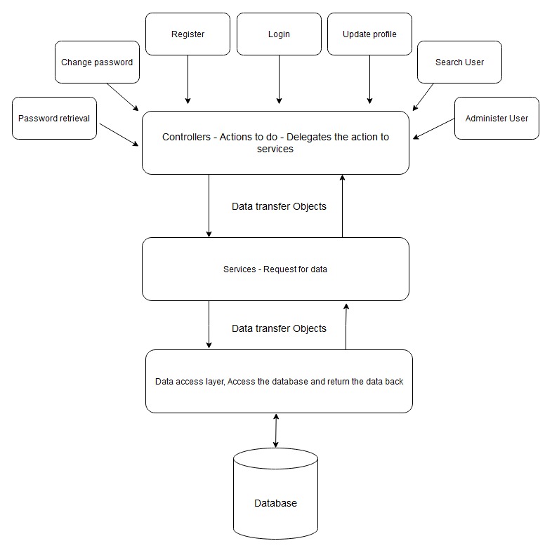
3. Application Block Diagram
Application Architecture

Slide 10
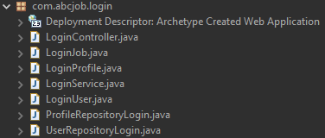
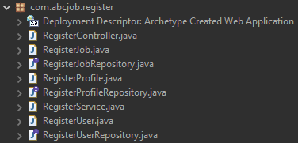
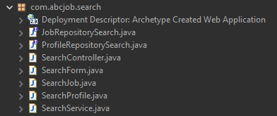


5. Models, Controllers, Classes Developed
Overview of Models, Controllers & Any Classes Developed
Login
Register
Search
Update Profile
Change Password

Slide 11
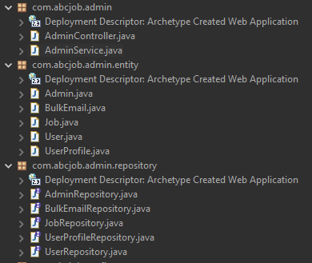
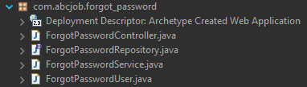
5. Models, Controllers, Classes Developed
Overview of Models, Controllers & Any Classes Developed
Admin
Forgot Password

Slide 12
6. Tool Screens
Tool Screens
Development Tools Screen captures
Eclipse IDE
MySQL Workbench
XAMPP

Slide 13
7. Classes - Entities
Entities
S. No. | Class Name | Description
1 | User | Entity for connecting to tb_users table, used for saving user account
2 | UserProfile | Entity for connecting to tb_user_profile table, used for saving user profile
3 | Admin | Entity for connecting to tb_admin table, used for fetch admin table
4 | Job | Entity for connecting to tb_jobs table, used for saving fetching jobs data
5 | BulkEmail | Entity for sending bulk email from admin side

Slide 14
8. Classes Developed
Business Classes
S. No. | Class Name | Description
1 | LoginService | Service class to handle business logic for user login
2 | RegisterService | Service class to handle business logic for user registering to the website
3 | AdminService | Service class to handle business logic for administration system of the website
4 | ForgotPasswordService | Service class to handle business logic for user password retrieval functionality
5 | ChangePasswordService | Service class to handle business logic for user changing their password
6 | UpdateProfileService | Service class to handle business logic for user who want edit their profile page
7 | EmailSenderService | Service class to handle business logic for sending email
8 | SearchService | Service class to handle business logic for search user and view user profile page

Slide 15
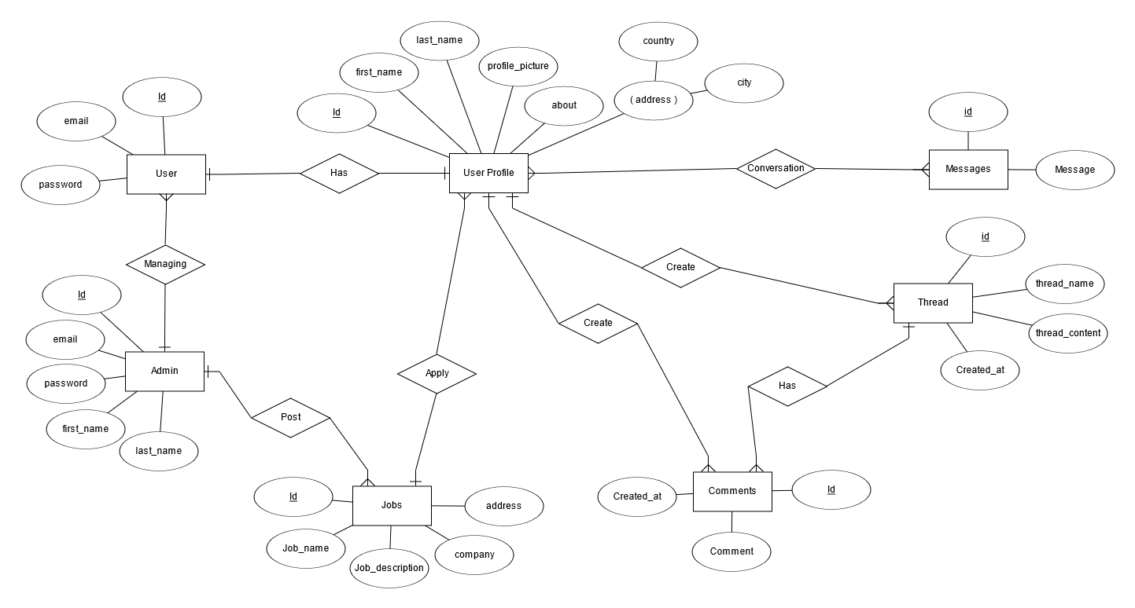
9. Database Design
ER Diagram Developed in Module 4

Slide 16
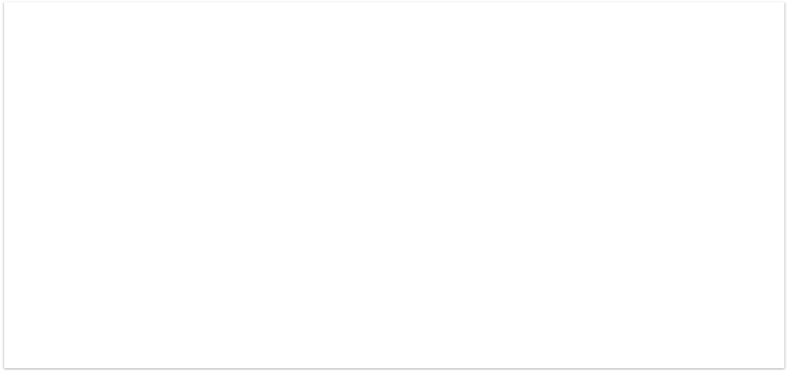
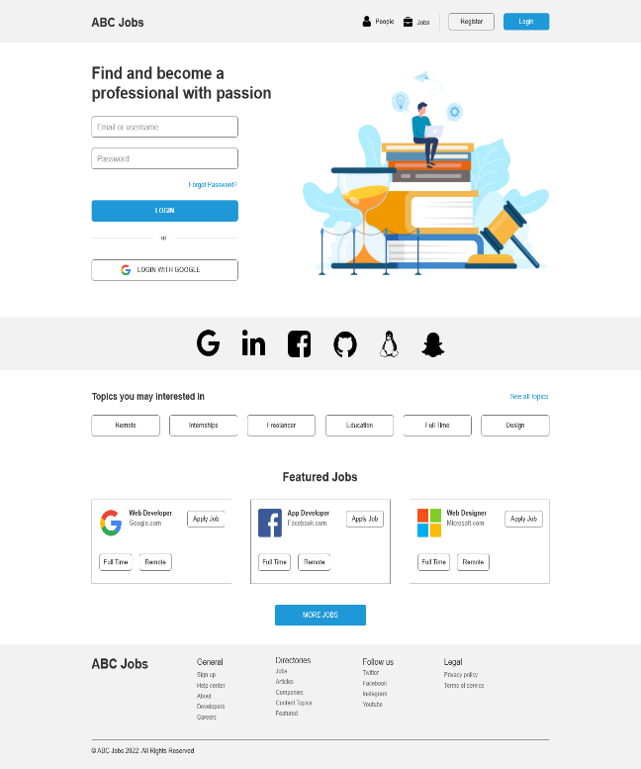
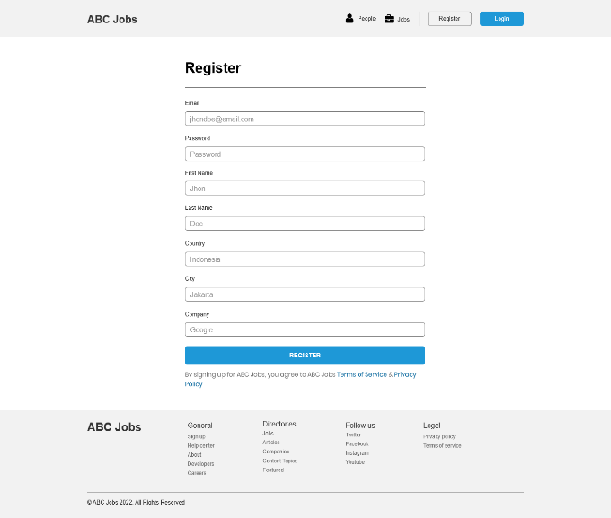
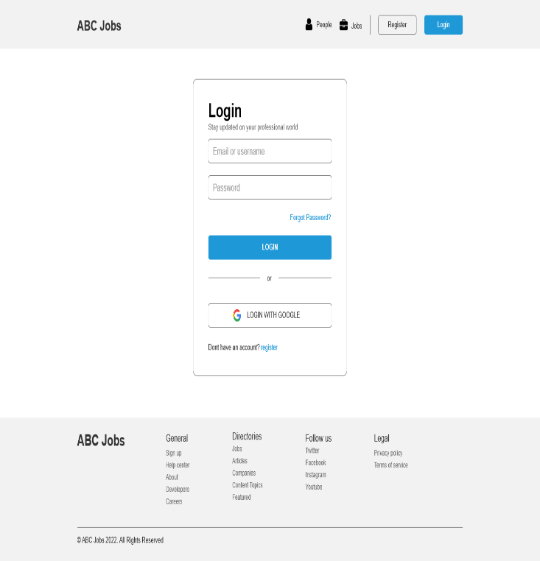
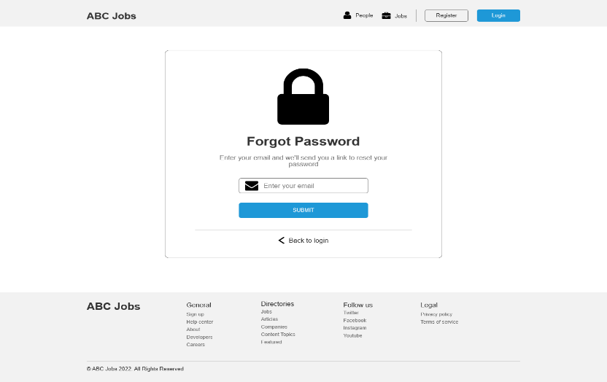
10. UI Design
UI Design Developed in Module 3
Homepage
Registration Page
Login Page
Forgot Password page

Slide 17
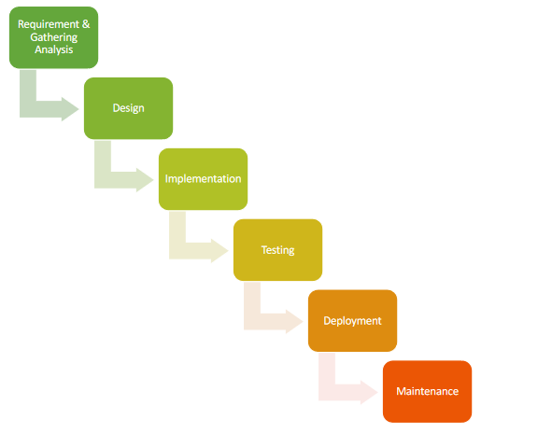
12. Software Development Methodology
Software Development Methodology being used
Waterfall Model
The waterfall model is a breakdown of project activities into linear sequential phases, where each phase depends on the deliverables of the previous one and corresponds to a specialization of tasks. The approach is typical for certain areas of engineering design.

Slide 18
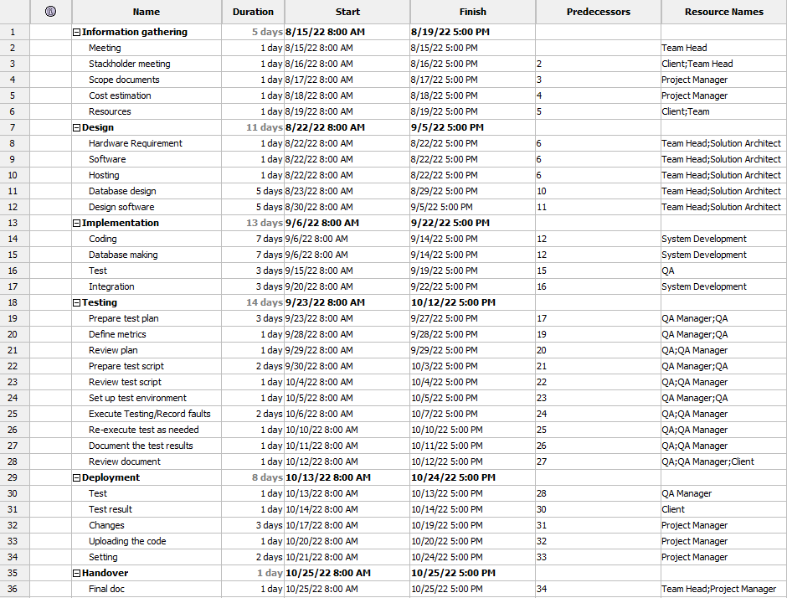
13. Project Plan
Project Plan

Slide 19
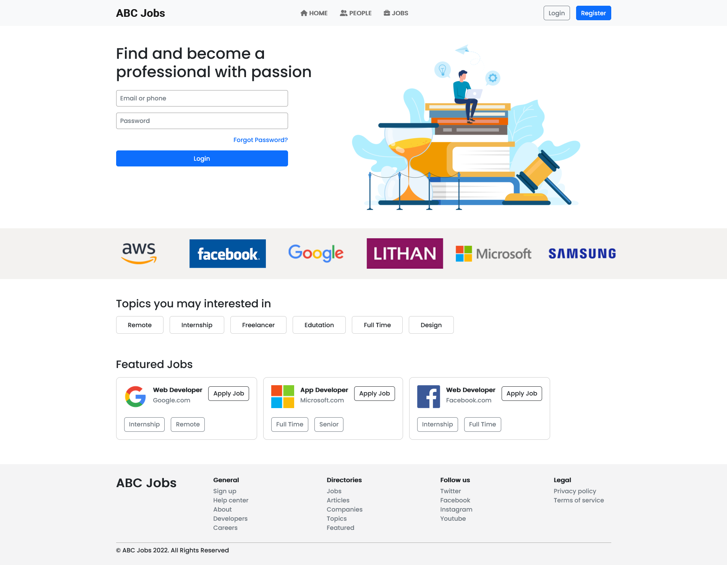
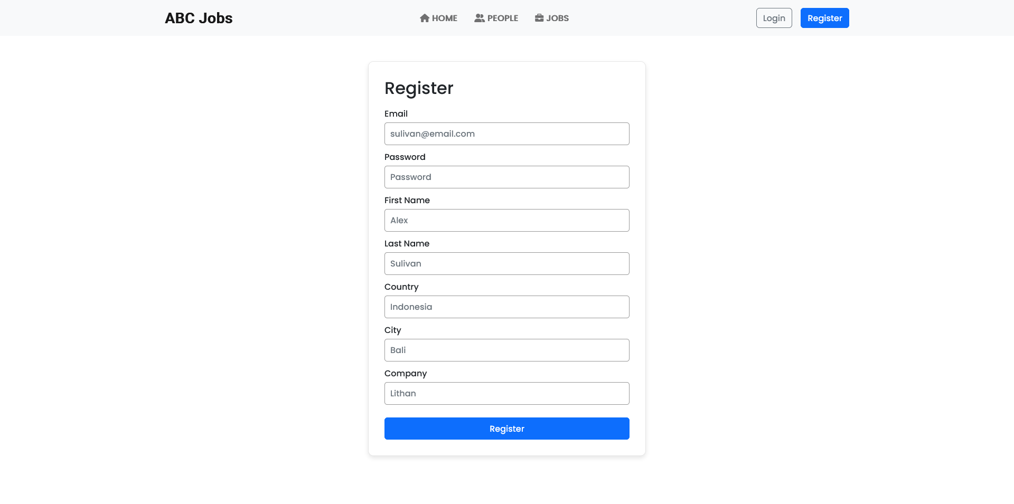
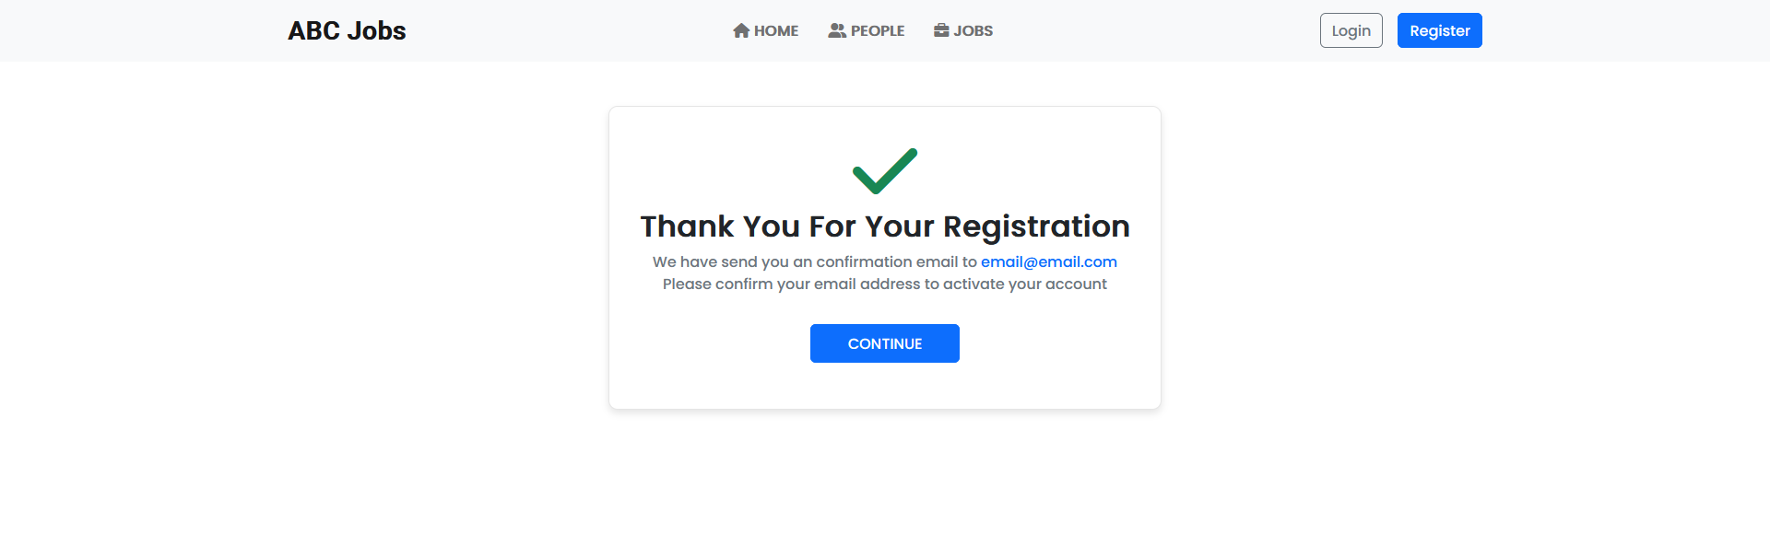
14. Application Screen Shots
Homepage
Registration Page
Registration Confirmation Page

Slide 20
15. Project Milestones & Tasks
Project Task ID | Project Task Description | Project Milestone ID
1 | Setup the Development Environment based on the Technical Development Environment | 1
2 | Power point Detailing the Business Process in the Proposed Application | 1
3 | Project Report detailing the Technical Design | 1
4 | Power Point Detailing the Project Plan | 1
5 | Develop the UI HTML standard pages (Based on Module 3 work) | 2
6 | Create common Struts Includes, Models, Views & Controllers | 2
7 | Develop Classes | 2
8 | Develop Struts Application | 2

Slide 21
16. Project Milestones & Tasks
Project Task ID | Project Task Description | Project Milestone ID
9 | Develop Test Cases | 3
10 | Develop Project Documentation | 3
11 | Develop User Manual | 3

Slide 22
17. Milestone Feedback & Action taken
Project Milestone ID | Milestone Feedback received from Tutor / Learning Facilitator | Action Taken (Yes / No)
1 | Adding more case diagram in project report | Yes
2 | Creating unit test and not UAT test for task 11 project report | Yes
3 | Adding screen capture for debugging mode in Eclipse | Yes

Slide 23
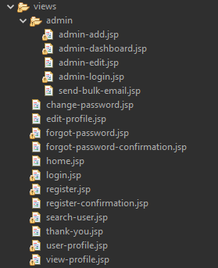
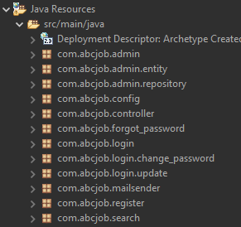
19. Project Results
List of Pages
  Home
  Login
  Register
  Change password
  Edit profile
  Forgot password
  Forgot password confirmation
  Register confirmation
  Search user
  Thank you page
  User profile login
  View user profile
  Admin login
  Admin edit
  Admin add
  Admin dashboard
  Send bulk email

Slide 24
20. Proposed Improvements
List of Improvements
  Creating more better code and not repeating that can be reused
  Consistent with naming convention

